Slide 1



Establishment of a Program Management Unit (PMU) to support Development Monitoring & Evaluation Office (DMEO) in the Institutionalization of Output Outcome Monitoring Framework, Government of India
December 2020

Slide 2
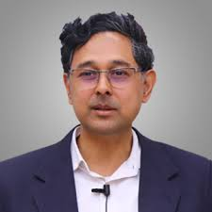







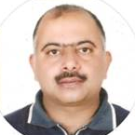










With you today …
Dr. Raja Venkataramani
Lead Capacity Building Expert
(Team Leader)
Advisory Panel
Rajib Sinha
Public Finance Leader
Anees Vijayan
Monitoring & Evaluation Expert
Dr. Debashish Biswas
International Development Expert
Arindam Guha
Government and Public Sector (GPS) Leader
Rishav Singh
Public Sector Expert
Rahul Akash Pandey
Technology Expert
Paramjyoti Chattopadhyay
Evidence based capacity building Expert
Arun Tyagi
Development Facilitation Expert
Marquee clients served by this team

Slide 3

Our understanding

Slide 4
Background
Development Monitoring and Evaluation Office (DMEO) has formulated Output-Outcome Monitoring Framework (OOMF) and has undertaken number of initiatives for implementing …….
Key objectives of the OOMF
NITI Aayog’s Journey in institutionalizing the OOMF
Link budgets and other inputs to outputs & outcomes though SMART indicators
Developed Outputs and Outcomes for schemes and sub-schemes across 68 ministries/Departments
Created Sector-specific teams
Monitor progress of programmes
Maximize development impact
Created Dashboard for Enabling monitoring of outputs and outcomes on an ongoing basis
Conducted evaluation of Schemes/ Programmes across 10 sectors and YY schemes
Rationalize portfolio of projects – scale up better performing schemes
Current Assignment
Intends to further Institutionalize OOMF across GoI and State Governments OOMF by selecting a consulting partner to conduct the following:
Design output and outcome based new schemes/ programmes in the near future
Review OOMF
Expand OOMF to Departments/ Ministries
Expand OOMF to States
Advocacy of Outcomes to transform M&E ecosystem
Strengthen the OOMF dashboard, stakeholder communications and online services

Slide 5
Challenges and Potential Solutions
Based on experience the current project will need to address the following issues/ challenges for effective institutionalization of OOMF………
Challenges
Our POV/ Potential Solutions
Different maturity levels of the schemes/ programmes
Different schemes/programmes having similar outcomes
Need to align the outcomes and outputs better for some schemes/programmes
OOMF design
Segregate the schemes/progammes by Value and years of existence
Define operational KPIs for specific schemes for better alignment with outcomes
Capacity
Inadequate resources at Ministry as well as state level – increase in time for obtaining information
Inadequate knowledge on usage of OOMF for Ministry level M&E and budgeting
Develop Guidelines, reference documents
Train the trainer programme
Regular structured capacity building
Knowledge management system
Performance agreement with Ministry/ Department with Niti Aayog
Incentives for adopting OOMF
Competition within Ministries/ Departments/ States for adopting OOMP
Institution
Lack of ownership / buy in - specially at the lower level
In some cases, frequent transfers to top management leading to institutional memory loss

Slide 6
Challenges and Potential Solutions
Based on experience the current project will need to address the following issues/ challenges for effective institutionalization of OOMF………
Challenges
Our POV/ Potential Solutions
Lack of baseline data for many of the schemes/ programmes leading to difficulty in target setting
Unavailability of data for some outputs and outcomes
Some indicators are not aligned to the data that is collected as part of regular MIS
Creating baselines as per availability of data –years may be different depending of the maturity of the scheme/ programme
In some cases we may need to monitor inputs/ operational KPIs before moving to output and outcome budgeting
Data
Need for standard operating processes for data collection, verification, updation and approval
Similar information requested by different agencies – lack of coordinated data collection
Inadequate linkage with existing budgeting process
Create an user friendly dashboard
Guidelines/ SOPs of various processes updated from time of time
Bolt-on/ integration with existing MIS where-ever possible
Process
DMEO may be regarded as another Monitoring & Evaluation agency
Lack of understanding about OOMF and its benefits at lower level
DMEO repositioning as “Supporting and Facilitation Agency”
Knowledge dissemination plan including Train the trainers programme
Knowledge products
Branding and Communication

Slide 7
Our approach

Slide 8
Approach and methodology
Imagine
Deliver
Run
3 Months
21 Months
STAKEHOLDER IDENTIFICATION, EXPECTATIONS & PROJECT GOVERNANCE
OOMF v2.0 DEFINED
LAUNCH OOMF v2.0
LITERATURE REVIEWS
1. Discover
4. Build
5. Scale
TRANSITION & INSTITUTIONALIZATION OF OOMF v2.0
2. Design
3. Refine
UNDERSTAND OOMF PROCESS AND METHODOLOGY & DEFINE THE PROBLEM
CONCEPTUALIZE OOMF V2.0 – TOOLKIT & DASHBOARD DESIGN
VALIDATE OOMF V2.0 – TOOLKIT & DASHBOARD DESIGN
DEVELOP & TEST OOMF V2.0 - DASHBOARD
EXPAND OOMF V2.0 TO MINISTRIES, DEPARTMENTS, STATES & UT
Charter of Success
Future ready Dashboard
Institutionalization across Ministries/ States
Continuous Advocacy, Sensitization Workshops & Trainings
Program & Risk Management

Slide 9

Maturity Assessment for Ministries/ Departments and States
Matured
Standardized
Feedback loop establishing for performance assessment of schemes on basis of OOMF
OOMF is informing budget allocation
Standard operating procedures exist for OOMF
OOMF being utilized for performance assessment
Formalized
Stakeholders aware of OOMF and its benefits
Acceptance of OOMF procedure throughout the institutions
Informal
KPIs aligned to OOMF
Data collected and shared in dashboard
Limited utility of OOMF for performance feedback
Early Stages
Non-Existent
OOMF developed
KPIs for Outcomes/ Outputs not aligned to standard MIS
Data not collected/ shared in time
Drivers for Maturity Enhancement
OOMF not used
Stakeholders not aware
KPIs not selected for Outputs/ Outcomes
Effective Communication Plan leveraging digital tools
1
2
Continuous training and knowledge transfer to Ministries/ States/UTs
3
Support in monitoring progress against implementation roadmap
4
Continuous training and knowledge building throughout the project
5
Facilitate coordination to ensure effective implementation of training plan

Slide 10
Workplan
Timeline
T M1 | M2 | M3
M4-6 | M7-9 | M10-12 | M13-14 | M15
M16 | M17 | M18 | M19 | M20 | M21 | M22 | M23 | M24
Pillar 1:
Review of OOMF
Assessment of existing M&E environment
Best practices’ study
Discussions on draft OOMF v2.0 Methodology & Toolkit
Finalization of OOMF v2.0 Methodology & Toolkit
Gap Identification
Pillar 2:
Conceptualize and develop OOMF dashboard 2.0
Dashboard Assessment & Fitness
Gather user requirements for dashboard 2.0
Conceptualize functional & technical architecture
Finalization of BRD, TDD and FDD and roadmap for dashboard 2.0
Bid Process Management & selection of vendor
Monitoring development, UAT & deployment for dashboard 2.0
Pillar 3:
Advocacy of Outcomes
Existing advocacy initiatives, materials, communication channels
Draft roadmap for advocacy & integrated communication plan
Finalization of Integrated Communication Plan
National Workshop on OOMF v2.0
Key Activities
Brainstorming sessions with DMEO to develop strategies to educate, inform & engage
Run – Scale
Run – Scale
Pillar 4:
Expand OOMF to Departments/ Ministries
Shortlisting M/Ds
Guidelines & Checklist for Dashboards
Sensitization workshops, Training Materials
MoUs/ SoIs with M/Ds
Stakeholder Discussions
Run – Scale
Run – Scale
Assess M/Ds level M&E environment
Pillar 5:
Expand OOMF to States
Shortlisting of States/UT
Collaboration with Training Institutes
Sensitization workshops, training material
MoUs/ SoIs with States/UT
Stakeholder Discussions
Run – Scale
Run – Scale
Assess state level M&E environment
Program Management, Quality & Risk Assurance
Project Charter & Governance Mechanism, Technical Handholding Support, Inter-agency coordination, Communication Management, Status Reporting, Program, Quality & Risk Management
- Inception Report; P1: -OOMF Documentation; - Draft OOMF v2.0 toolkit; - Draft OOMF v2.0 improvement test report; - Final OOMF v2.0 toolkit; - Final OOMF v2.0 improvement test report; P2: - Stakeholder-wise requirement documentation and roadmap for dashboard 2.0; - Vendor ToR; - Bidding Documents; - BRD; P3: - Communication plan; P4: - Finding and recommendations report per department; - Workshop design and training material; - Guidelines and checklists for dashboard; P5: - Maturity assessment frameworks and 5 assessment reports; - Course curriculum; - Progress reports; - Training reports
Draft of all outputs prepared will be presented to officials for review. Discussion/meeting will be undertaken with the relevant officials and recommended changes will be incorporated in the final output. All final outputs/reports will then be submitted.
Key Output/
Deliverables:
Imagine - Discover & Design
Deliver - Refine & Build
Run - Scale
Weekly/Monthly updates for Working Group (WG)
Stakeholder Trainings/Workshops
Legend:
Advocacy Contents, Materials
Outputs / Deliverables

Slide 11






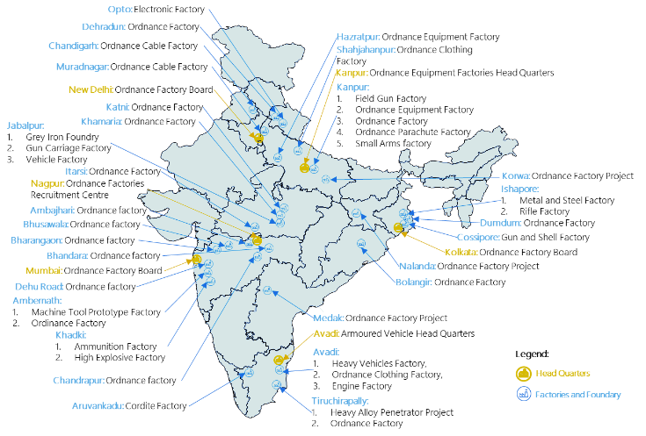
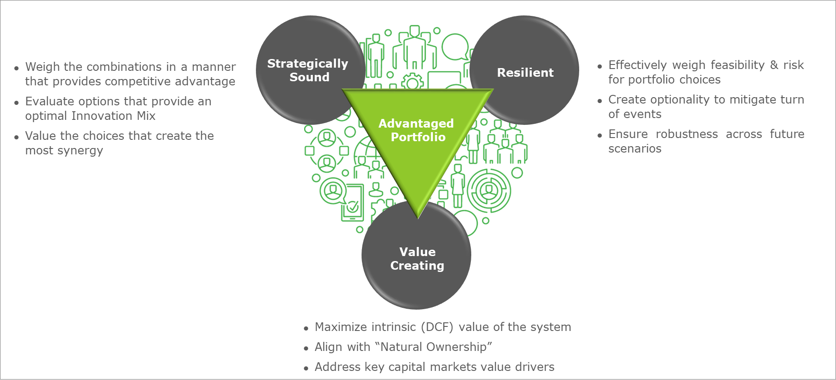


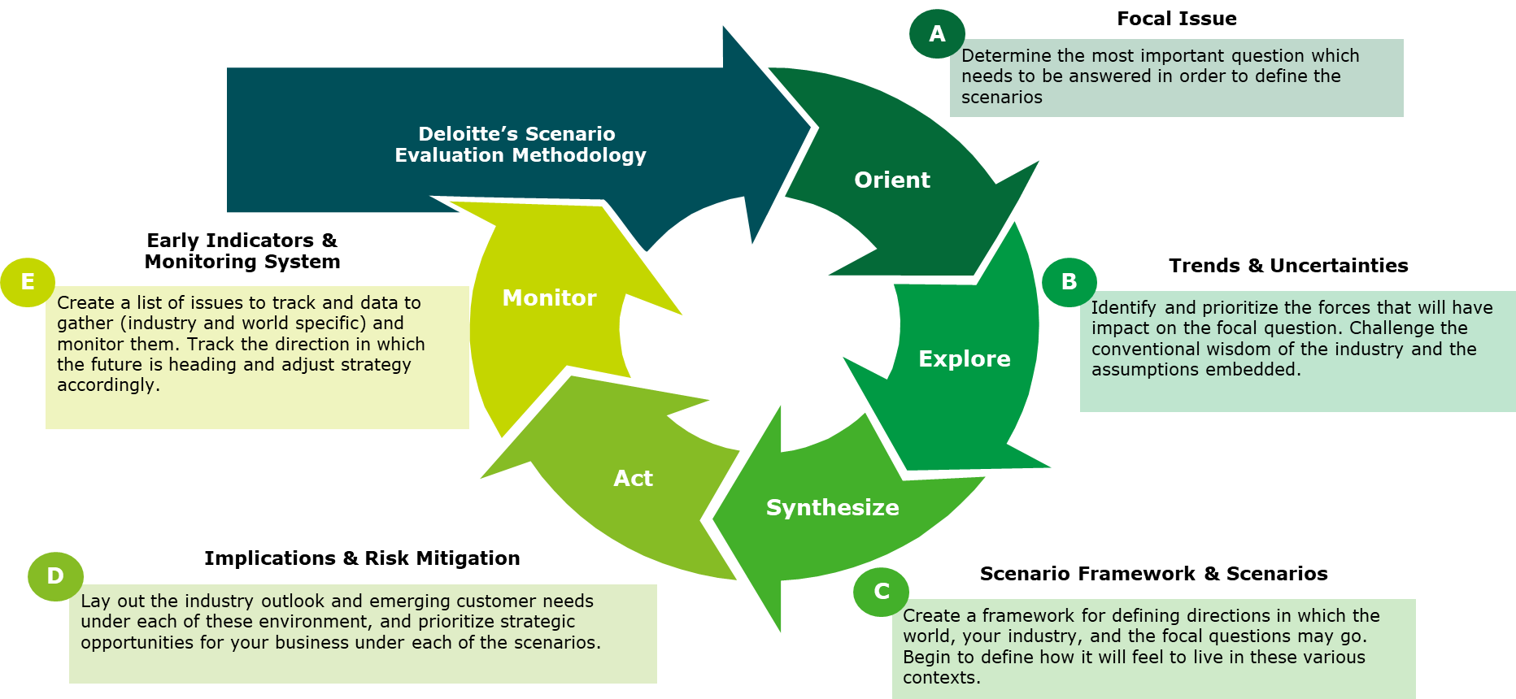
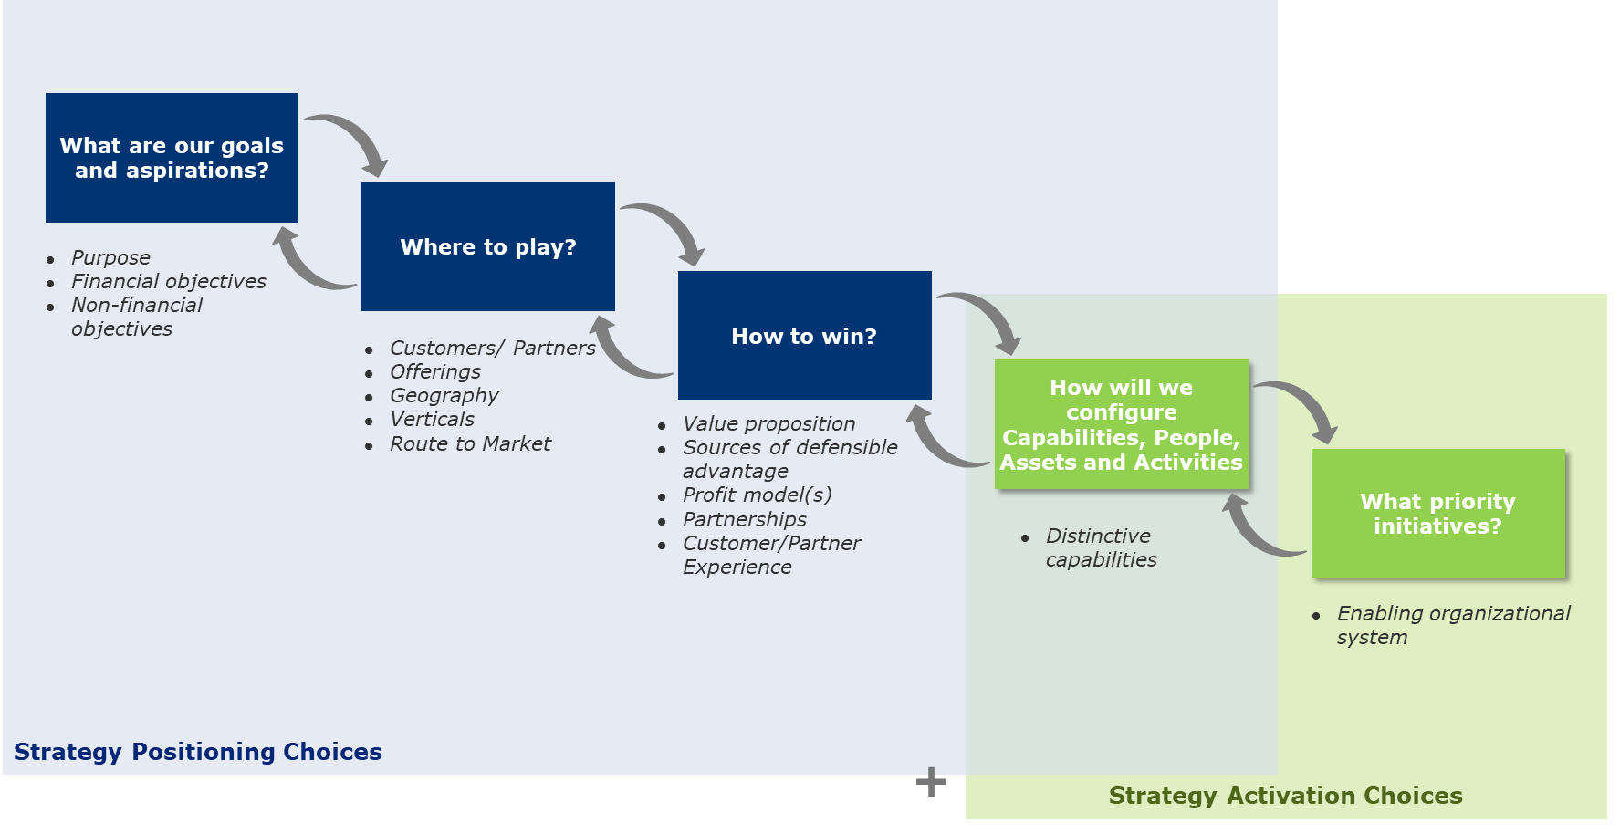
Why Deloitte
Demonstrated track record of successfully manning Program Management Unit in Government and several projects on outcome budgeting
Experienced & multidisciplinary team with a blend of international expertise & national focus
  Cross Functional Team with experience in Corporatization
500+
  Years of Combined Experience of Proposed Team
  Experience with the Top PSUs and Government Boards in India
  PSU with extensive experience in Asset Valuation
  No.1 in Legal 500 Ranking - significant corporatization experience
WHY DELOITTE?
We are where you are & will hit the ground running on day one with understanding of OOMF & our tested framework
  Central PMO team in Delhi
  Regional offices at 14 locations across India
Usage of Tools & Accelerators to meet
timeframe and objectives
  Deloitte’s Public sector value map
  Deloitte’s Advantage
  Portfolio Framework
  Operational
  Handbook
  Org design
  accelerator
Innovative & pragmatic approach to deliver this transformation successfully addressing the
key challenges and minimizing the risks
  Scenario Planning Approach
  Best-in-Class Strategic Choice Cascade Framework
  (Playing to Win)

Slide 12
Deloitte refers to one or more of Deloitte Touche Tohmatsu Limited, a UK private company limited by guarantee (“DTTL”), its network of member firms, and their related entities. DTTL and each of its member firms are legally separate and independent entities. DTTL (also referred to as “Deloitte Global”) does not provide services to clients. Please see www.deloitte.com/about for a more detailed description of DTTL and its member firms.
This material has been prepared by Deloitte Touche Tohmatsu India LLP (“DTTILLP”), a member of Deloitte Touche Tohmatsu Limited, on a specific request from you and contains proprietary and confidential information. This material may contain information sourced from publicly available information or other third party sources. DTTILLP does not independently verify any such sources and is not responsible for any loss whatsoever caused due to reliance placed on information sourced from such sources. The information contained in this material is intended solely for you. Any disclosure, copying or further distribution of this material or its contents is strictly prohibited.
Nothing in this material creates any contractual relationship between DTTILLP and you. Any mutually binding legal obligations or rights may only be created between you and DTTILLP upon execution of a legally binding contract. By using this material and any information contained in it, the user accepts this entire notice and terms of use.
©2020 Deloitte Touche Tohmatsu India LLP. Member of Deloitte Touche Tohmatsu Limited
Deloitte Touche Tohmatsu India Private Limited (U74140MH199 5PTC093339), a private company limited by shares, was converted into Deloitte Touche Tohmatsu India LLP, a limited liability partnership (LLP Identification No. AAE-8458),with effect from October 1, 2015.

Slide 13
IMAGINE - Discover and Design
Assess the current OOMF, identify gaps, integrate learnings and conceptualize OOMF v.2.0 and OOMF Dashboard 2.0 including advocacy materials
Key tasks and considerations
Deliverables
Leverage the existing evaluation studies done and findings (by sectoral teams)
D/Ms specific Capacity Building Roadmap & Dashboard Guidelines
State specific M&E Toolkits & Capacity Building Roadmap
Development of prioritization framework for selection of M/Ds and States/UTs
Ensure user data needs – collection, validation, analysis and reporting
Leveraging emerging analytical tools and techniques towards design of FRS for dashboard
Draft OOMF v.2 Toolkit - Policy, Manual, Process, Methodology
OOMF Dashboard 2.0 Draft Business, Functional & Technical Requirement Documents
Advocacy Materials, Integrated Communication Plan
Enable Feedback loop mechanism for performance informed decision making
Critical success factors
Advocacy & Communication Plan- Evidence based advocacy with hard budget numbers; Communication platform – 1) Earned, 2) Owned, 3) Paid and 4) Shared
Timely sharing of data/information
Timely selection of M/Ds and States/UTs and signing of MoUs
Policy continuity
Strict adherence to Dashboard development timelines
Deploy survey questionnaire, virtual brainstorming session, prioritization framework to assess scheme maturity, issues and challenges in dashboard, selection and utilization of indicators for OOMF

Slide 14
DELIVER – Refine and Build
Assess the current OOMF, identify gaps, integrate learnings and conceptualize OOMF v.2.0 and OOMF Dashboard 2.0 including advocacy materials
Key tasks and considerations
Deliverables
Validation walkthroughs for finalization of OOMF 2.0
Training Materials, Conduct
of Trainings,
Institutional Collaborations, Training
Leveraging Deloitte’s Public procurement experience in bid process management and program managing development of OOMF 2.0 dashboard
Develop toolkits, brochures and other communication utilities to advocate for OOMF 2.0 across ministries, departments and states
Leveraging Deloitte’s international collaborations to bring in international best practices via conferences and workshops
Final OOMF v.2 Toolkit - Policy, Manuals, Process, Methodology, Framework
Development & Deployment of OOMF Dashboard 2.0
Sustained Advocacy Roadmap & Advocacy Materials
Forge institutional collaborations with training institutes
Critical success factors
Phased approach to trainings – design and delivery of trainings on the basis of assessed maturity of M/Ds and States/UTs
Effective communication with M/Ds and States
Strict adherence to Dashboard development timelines
Counterpart team continuity
Arranging virtual learning sessions and lessons learnt from case studies/best practices

Slide 15
RUN – Scale
Significant advocacy & training programs at M/Ds & States/UT level for institutionalization of OOMF v2.0
Key tasks and considerations
Deliverables
Conduct trainings for M/Ds officials and for each of the states’ Planning & Finance Dept. officials coupled with Feedback mechanism – Training of Trainers
Training Materials, Conduct of Trainings, Internalization of OOMF in decision making
Periodic Advocacy Materials
Coherent mapping of programs & activities
Building effective M&E environment & internalizing use of performance data in internal program reviews
Update contextualized training materials
Training Materials, Conduct of Trainings, Strengthening M&E environment
Regional workshops for sharing success stories
Critical success factors
Update advocacy materials
Mainstreaming outcome based budgeting through policy & administration
Budget for M/Ds for FY 2022-23 & 2023-24 must be performance informed
Dedicated M&E units in M/Ds and at States/UT
Strong data analytics & technology capabilities
Continuous knowledge transfers through online & offline mode

Slide 16
Good Practices
Outcome Based Budgeting (OBB) represents an evolutionary step in Malaysia’s implementation of PBB
Key Design Features
Capacity Building Learnings
Systematic M&E System
Focus on outcomes
Design of OBB logical framework for identifying contribution of programs and a comprehensive IT system to support
Identification of resource leaders and desk officers for continuous training, training of trainers
6 Transformation Levers
Priorities aligned vertically
Authority and Accountability
MOF established a small independent unit (OBB team) to manage the design and implementation of the OBB system
Extensive strategic programming workshops, capacity building
Managing cross-cutting initiative
Linkage of programs and activities to National Development Goals starting 10th Malaysia Plan
(2011-2015)
Efficient change management, staff training, stakeholder outreach were all key components of the MoF’s strategy for OBB roll-out
Budget Coordination
Key challenges
Lack of understanding of the concepts of performance budgeting
Inappropriate staff capacity in performance evaluation
Poor quality of information in the results framework resulting in significant confusion
Asymmetry between Finance and line ministries in program knowledge
Lack of demand for performance information due to absence of rewarding mechanism against good performance
Identifying the right IT solution and translating business requirements into an IT system
Interpretation of performance information and generating policy responses
Lack of demand for performance information due to absence of rewarding mechanism against good performance

Slide 17




Dashboard
The Deloitte Approach
Our Dashbboard and reporting solution addresses the key constraints of People, Process and Technology to empower each decision maker to
have an Enterprise Data Warehouse to automate MIS of their KPIs, with customized views and the ability to deep-dive into specific areas through drill down, providing
end to end automation and that is available on mobiles and desktops for “Paperless reviews”
CRITICAL BUSINESS DIMENSIONS
KPI FRAMEWORK & INFORMATION LAYERING
KPI AUTOMATION & EDW CONCEPTUALIZATION
Supplier / Operations
Strategic
Tactical
Operational
Support
Automated KPI dashboards for effective decision making on business and operational matters under focus
Strategy
Stakeholders
REAL TIME KPI DATA ANALYSIS
People
DASHBOARDS
External
environment
3- layered
functioning
Process
NOTIFICATION &
EMAIL ALERTS
Customers
ENTERPRISE DATA
WAREHOUSE
Technology
Our solution overcomes all the challenges that are encountered in setting up of Dashboard and reporting solution because of:
Right Approach
Right Structure
Right Architecture

Slide 18
Communication plan and Knowledge transfer
Our communication plan will involve constant communication with all stakeholders, including select Ministries/ States. We will solicit inputs through surveys and conduct workshops. Issues to be solved at this stage are:
Technical support and handholding towards roll out of OOMF
Support in Organization of Workshops/ Training Seminars
Who?
Knowledge Transfer
Identify key stakeholders that should participate on the workshop
Facilitate coordination to ensure effective implementation of training plan
Support in monitoring progress against implementation roadmap
How?
Design a methodology for the whole process of workshopping (communications, sessions, timing, etc.
Approach
Continuous training and knowledge building throughout the project
What?
Define Outcomes, Outputs and Indicators and key issues to be addressed on this workshop
Trainings and Workshops
Knowledge Storage
Discuss the proposed implementation roadmap
Design Agenda materials such as case studies
Outline delivery mechanism and evaluation methodology
Formalize evaluation strategy, workshops will be evaluated and findings to be presented to officials
In a shareable framework for policy makers
Managed for future decision making
Active data collection from secondary sources undertaken on a continuous basis
When?
Define correct timing of future workshop sessions as well as the timeline to carry out the results and conclusions of the workshop, with correct prioritization
Where?
Define correct timing of future workshop sessions as well as the timeline to carry out the results and conclusions of the workshop, with correct prioritization

